Slide 1
Natural Language Processing (NLP)
Lecture 6: Language Models
Dr. Muhammad Taimoor Khan

Slide 2
“You are uniformly charming!” cried he, with a smile of associating and now and then I bowed and they perceived a chaise and four to wish for. Random sentence generated from a Jane Austen trigram model
Please turn your homework ...
Predict the next work!
Or chose the correct sentence between
all of a sudden I notice three guys standing on the sidewalk and on guys all I of notice sidewalk three a sudden standing the

Slide 3
Correcting spelling mistakes
Their are two midterms in this class (their instead of there)
Machine Translation etc.

Slide 4
Language Models
Models that assign probabilities to sequences of words
The simplest of such models are galled N-grams
An n-gram is a sequence of N n-gram words: a 2-gram (or bigram) is a two-word sequence of words like “please turn”, “turn your”, or ”your homework”, and a 3-gram (or trigram) is a three-word sequence of words like “please turn your”, or “turn your homework”.
Using n-gram models to estimate the probability of the last word of an n-gram given the previous words

Slide 5
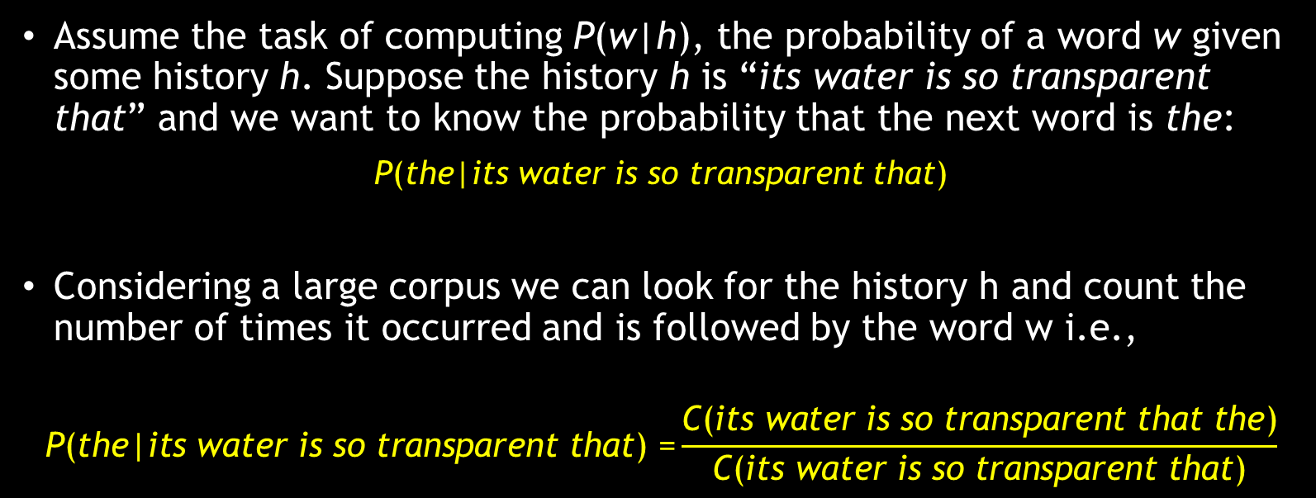
N-grams
Assume the task of computing P(w|h), the probability of a word w given some history h. Suppose the history h is “its water is so transparent that” and we want to know the probability that the next word is the:
P(the|its water is so transparent that)
Considering a large corpus we can look for the history h and count the number of times it occurred and is followed by the word w i.e.,
$$\text{P}\text{(}\text{the}\text{|}\text{its} \text{water} \text{is} \text{so} \text{transparent} \text{that}\text{) =}\frac{\text{C}\text{(}\text{its} \text{water} \text{is} \text{so} \text{transparent} \text{that} \text{the}\text{)}}{\text{C}\text{(}\text{its} \text{water} \text{is} \text{so} \text{transparent} \text{that}\text{)}}$$

Slide 6
Counts are not enough!
While this method of estimating probabilities directly from counts works fine in many cases, it turns out that even the web isn’t big enough to give us good estimates in most cases. This is because language is creative; new sentences are created all the time, and we won’t always be able to count entire sentences.
Even the simplest of sentences may have zero count.
Moreover, counting the desired n word sequence and dividing it by all possible n word sequences in the corpus is not a feasible approach either.

Slide 7

Formulization as Probabilities
To represent the probability of a particular random variable X_{i} taking on the value “the”, or P(X_{i} = “the”), we will use the simplification P(the).
We’ll represent a sequence of N words either as w₁ ...w_{n} or $w_{1}^{n}$
The joint probability for sequence
P(X₁ = w₁, X₂ = w₂, X₃ = w₃,..., X_{n} = w_{n})
Can simply be represented as
P(w₁,w₂,...,w_{n})

Slide 8

Chain Rule of Probability
In order to compute probability for the entire sequence, we decompose its probability into chain rule of probability as,
P(X₁...X_{n}) = P(X₁)P(X₂|X₁)P(X₃|$X_{1}^{2}$)...P(X_{n}|$X_{1}^{n−1}$)
Or simply
$$P\left(X_{1}…X_{n}\right)=\prod_{k=1}^{n}{P(X_{k}|X_{1}^{k−1})}$$
Applying chain rule to a sequence of words,
$$P\left(w_{1}^{n}\right)=\prod_{k=1}^{n}{P(w_{k}|w_{1}^{k−1})}$$

Slide 9

Expectation Maximization Likelihood
Normalize counts to represent probabilities i.e., likelihood of the next word is evaluated between 0 to 1.
It can be calculated as,
$$P\left(w_{n} | w_{n−1}\right)=\frac{C(w_{n−1}w_{n})}{\sum_{w}{C(w_{n−1}w)}}$$

Slide 10

Chain Rule (Example)
P(Its, water, is, so, transparent, that)
Intuition:
Chain rule of probability
$$P\left(w_{1}^{n}\right)=\prod_{k=1}^{n}{P(w_{k}|w_{1}^{k−1})}$$
P(“its water is so transparent”) = P(its) × P(water|its) × P(is|its water) × P(so|its water is) × P(transparent|its water is so)

Slide 11
The chain rule shows the link between computing the joint probability of a sequence and computing the conditional probability of a word given previous words.
However, probabilities of longer sequences face the same problem.
The intuition of the n-gram model is that instead of computing the probability of a word given its entire history, we can approximate the history by just the last few words.

Slide 12
Markov Assumption
Simplifying assumption
P(the | its water is so transparent that) ~ P(the | water is so transparent that)
Or may be
P(the | its water is so transparent that) ~ P(the | is so transparent that)

Slide 13
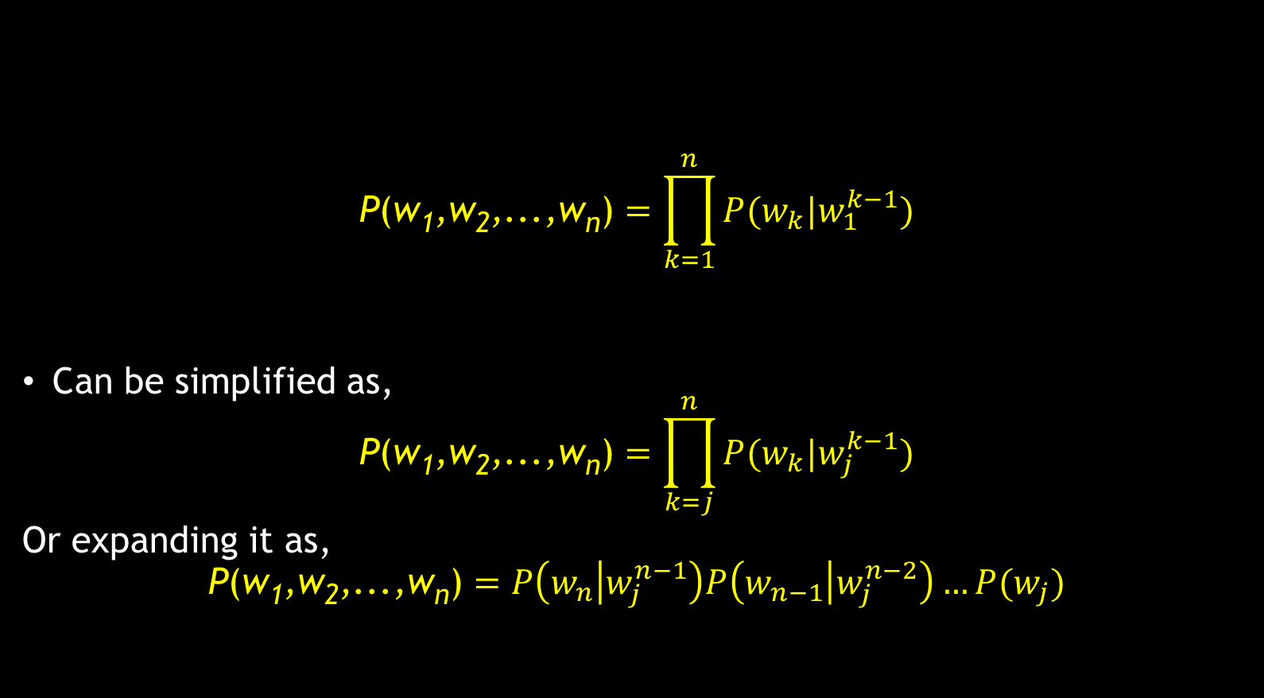
Markov Assumption
$$\text{P}\text{(}\text{w}\text{1}\text{,}\text{w}\text{2}\text{,...,}\text{w}\text{n}\text{)}=\prod_{k=1}^{n}{P(w_{k}|w_{1}^{k−1})}$$
Can be simplified as,
$$\text{P}\text{(}\text{w}\text{1}\text{,}\text{w}\text{2}\text{,...,}\text{w}\text{n}\text{)}=\prod_{k=j}^{n}{P(w_{k}|w_{j}^{k−1})}$$
Or expanding it as,
$$\text{P}\text{(}\text{w}\text{1}\text{,}\text{w}\text{2}\text{,...,}\text{w}\text{n}\text{)}=P\left(w_{n} | w_{j}^{n−1}\right)P\left(w_{n−1} | w_{j}^{n−2}\right)…P(w_{j})$$

Slide 14

Simplest Case: Unigram
$$P\left(w1,w2,w3,…wn\right)≈\prod_{i}{P(wi)}$$
Assuming history to be irrelevant, thus:
$$P\left(w3\right)≈P\left(w3\right)$$
$$P\left(w2\right)≈P(w2)$$
$$P\left(w6\right)≈P(w6)$$
For the sentence “its water is so transparent that” the probability of the next word is independent of the earlier strings.
A word with high probability across the corpus would be repeatedly predicted as next word.

Slide 15
Unigram Generative Model (Sample Text)
fifth, an, of, futures, the, an, incorporated, a, a, the, inflation, most, dollars, quarter, in, is, mass. thrift, did, eighty, said, hard, 'm, july, bullish that, or, limited, the

Slide 16
Bigram Model
Conditioned on the previous word
$$P\left(wi | w1, w2, w3…, wi−1\right)≈P(wi|wi−1)$$
Text generated with bigram model
texaco, rose, one, in, this, issue, is, pursuing, growth, in, a, boiler, house, said, mr., gurria, mexico, 's, motion, control, proposal, without, permission, from, five, hundred, fifty, five, yen outside, new, car, parking, lot, of, the, agreement, reached this, would, be, a, record, november

Slide 17

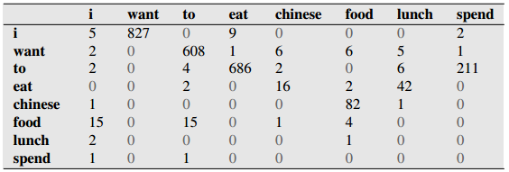
Bigram counts for eight of the words (out of V = 1446) in the Berkeley Restaurant Project corpus of 9332 sentences

Slide 18
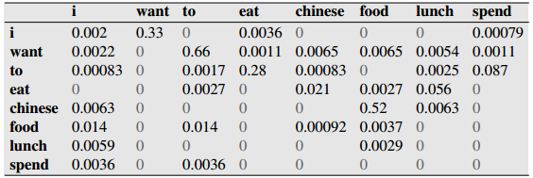
Bigram Probabilities (Normalized with Unigrams)

Slide 19
High N-grams
Tri-grams conditioned on the past two words
4-grams are conditioned on the past three words
Can go upto 5-gram, 6-gram etc.
However, the probabilities tends to get close to zero for 4-grams and above (So practically they are not viable)

Slide 20
N-gram Models
We can extend to tri-grams, 4-grams, 5-grams …
In general this is an insufficient model for language because language has long distance dependencies
“The computer which I had just put into the machine room on the fifth floor crashed.”
But we can often get away with N-gram models

